Slide 1
Ecosystems: Lesson 1, Activity 2
Your ideas about
“Where is the Carbon in Ecosystems?”

Slide 2
What is an ecosystem?
An ecosystem is a place that has the same climate, landforms, soils and vegetation.

Slide 3
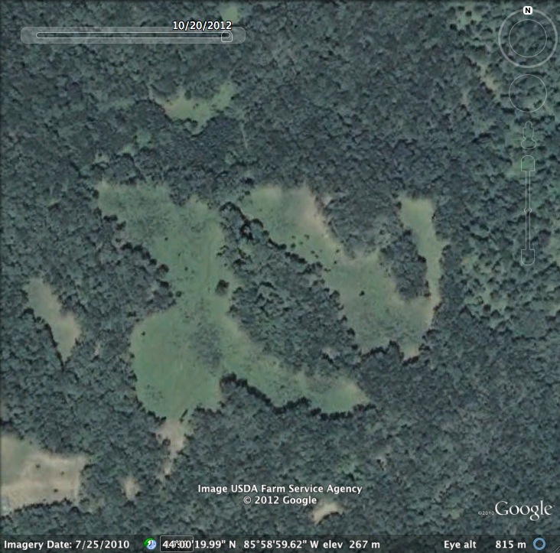
Where is the meadow ecosystem?
Notes:
This image was taken from Google Earth at these coordinates:
44°00'19.99" N 85°58'59.62" W
This meadow is in the Manistee National Park.

Slide 4
Meadow ecosystem is outlined in red. The rest of the image is a forest ecosystem.

Slide 5
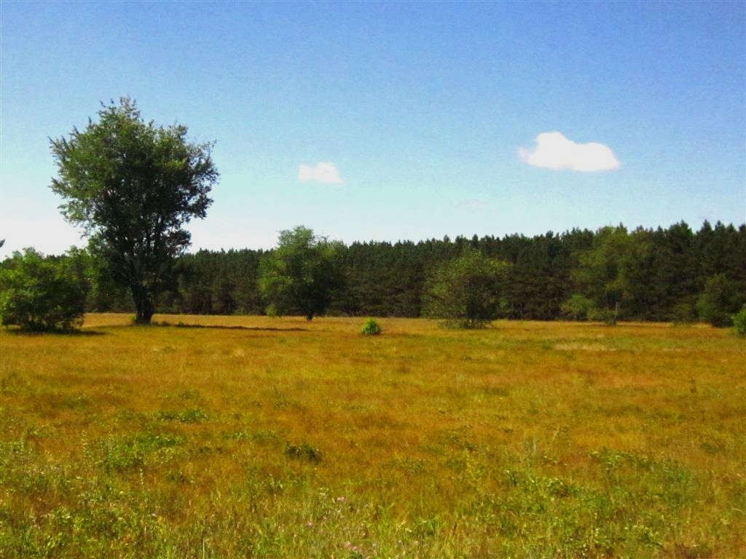
Zoom to the land surface
Notes:
Meadow in the Manistee National Forest.
http://plantsamazeme.blogspot.com/2011/09/newaygo.html

Slide 6
Meadow ecosystems have many living things:
Plants:
Animals:
Notes:
Meadows may include:
Plants– grasses, golden rod, tree seedlings (oak, pine, maple), clover, daisy, milkweed, etc
Animals– rabbits, birds, insects (ants, bees, grasshoppers), foxes, deer, snakes etc
For more information: http://mnfi.anr.msu.edu/communities/community.cfm?id=10697
This meadow is probably a mesic praire or dry-mesic or sand prairie
This meadow is not a natural meadow, but was cleared some time between 2005 and 2009.

Slide 7
Where is the carbon in the ecosystem?
Name all the places where you would find carbon in an ecosystem:
1.

Slide 8
Where is the carbon in the ecosystem?
For all of the places you named, what kinds of molecules are the carbon atoms in?
Which of those molecules are organic versus inorganic?
Notes:
Go back to the previous slide and put a star by all of the places where carbon is organic. The inorganic carbon is in carbon dioxide in the atmosphere.

Slide 9
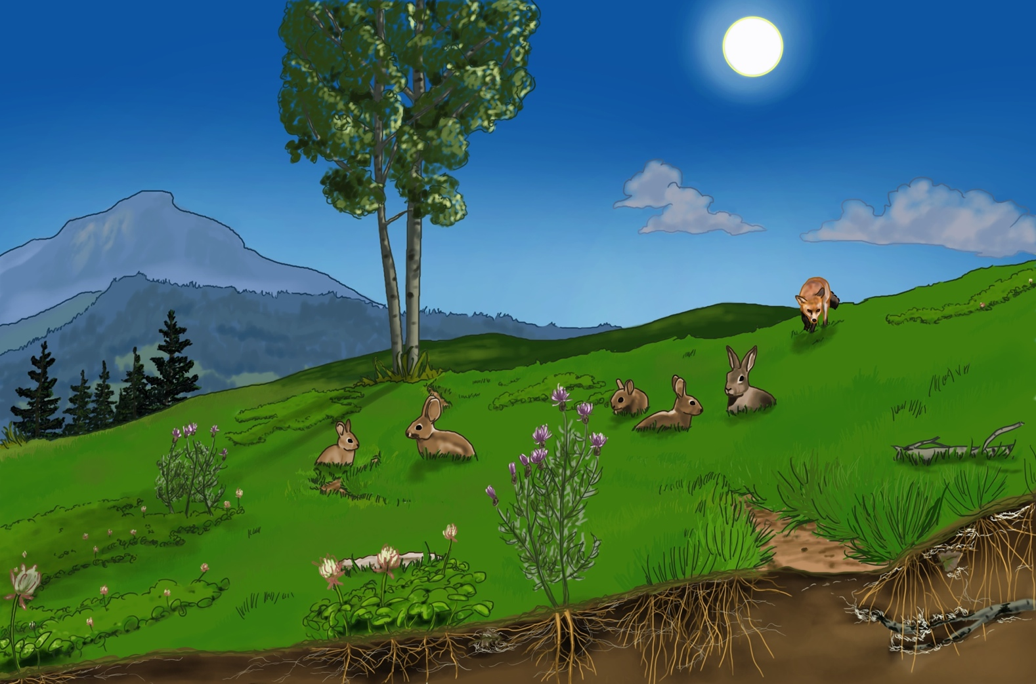
Where are the producers?
Producers do photosynthesis to create organic materials for food and for the materials that make up their parts

Slide 10
Where are the herbivores?
Herbivores eat plants and digest plant materials for food and for the organic materials that make up their parts

Slide 11
Where is the carnivore?
Carnivores eat other animals and digest animal materials for food and for the organic materials that make up their parts

Slide 12
Where are the decomposers?
Decomposers eat dead stuff and digest dead materials for food and for the organic materials that make up their parts
Notes:
Decomposers are fungi and bacteria.

Slide 13
Scientists group parts of ecosystems into “pools” of carbon

Slide 14
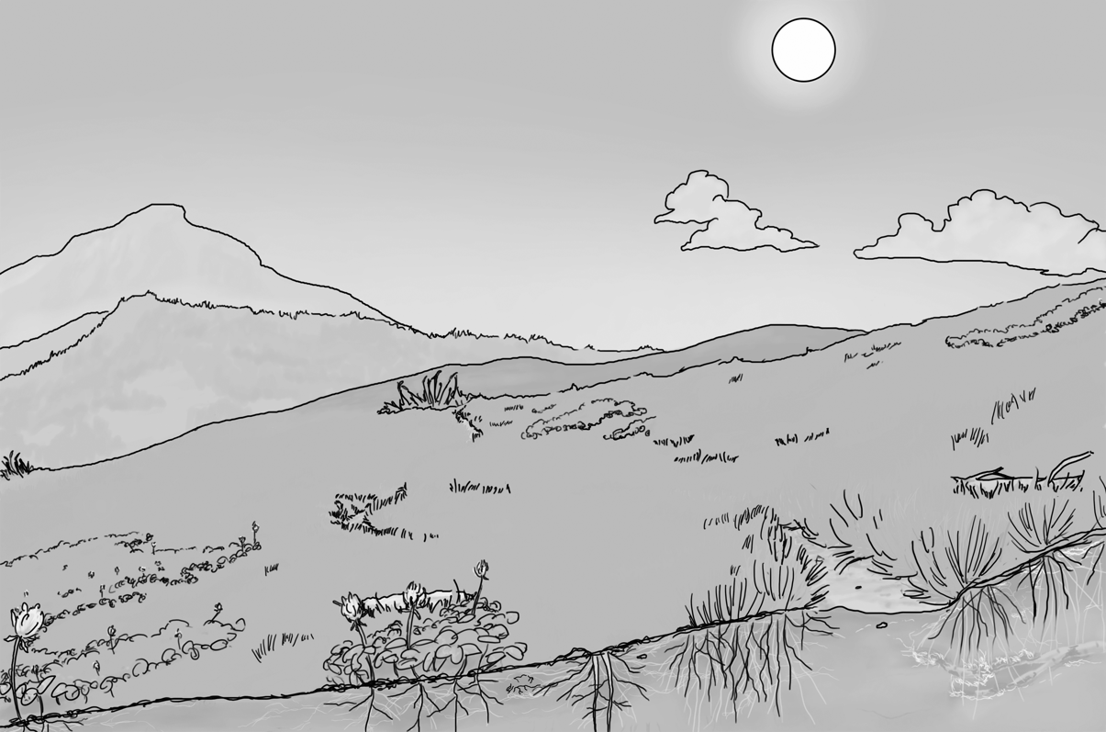
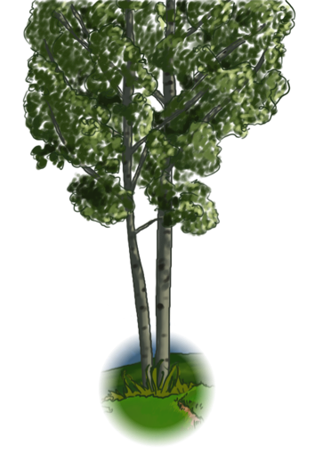
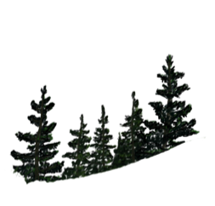
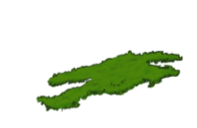
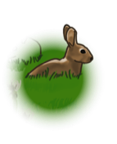
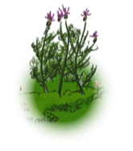
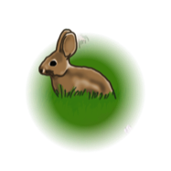
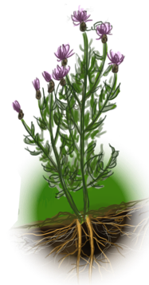
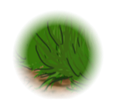
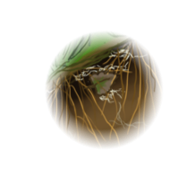
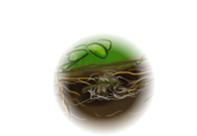
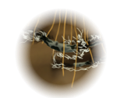
Carnivores organic carbon
Atmosphere CO₂
Herbivores organic carbon
Soil
Organic Carbon
Producers organic carbon
Notes:
ANIMATED SLIDE-- Use in ppt slide show mode

Slide 15
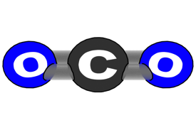
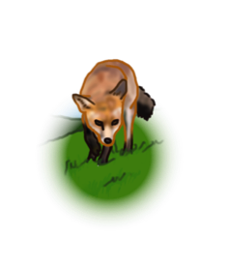
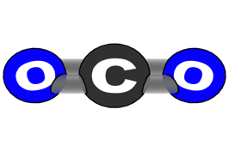
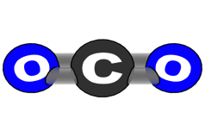
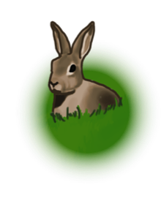
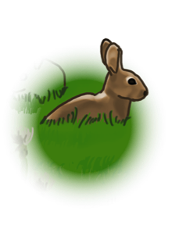
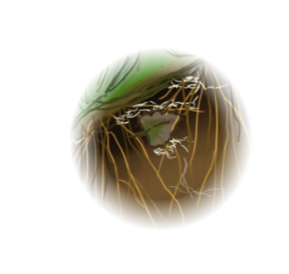
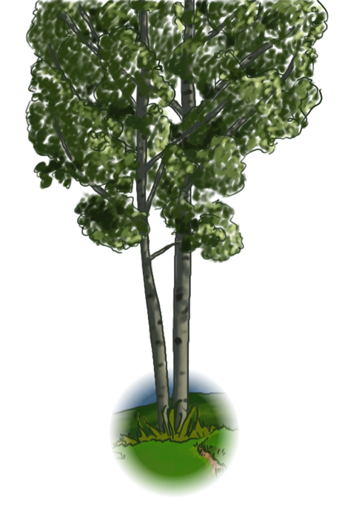
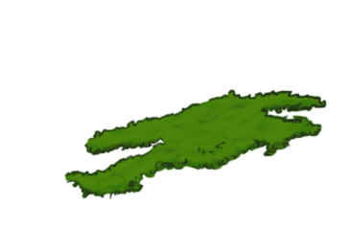
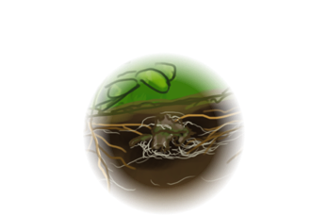
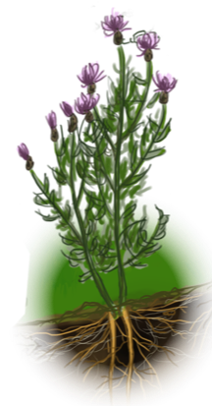
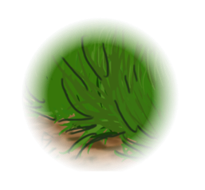
Carnivores
Organic Carbon
Atmosphere
CO₂
Herbivores
Organic Carbon
Soil
Organic Carbon
Producers
Organic Carbon
Notes:
The end result of the animation, but showing the pools up closer.

Slide 16
What is soil organic carbon?
It is a pool of carbon that contains:
dead plants and animals waiting to decay (be eaten by decomposers) AND
the organic material of live decomposers.
Notes:
The soil organic carbon pool can sometime be very large if there is lots of plant material and low decomposition rates. (Especially forests that are cold, like the tundra.)
When soils are dark brown, that color comes from dead organic matter that has not yet decayed.

